Slide 1
Chapter 22
Capacitance, Electric Energy Storage
Capacitors and Capacitance
Energy Stored in an Electric Field

Slide 2
New Words and Expressions
capacitance 电容
capacitor (condenser) 电容器
dielectric 电介质
farad 法拉
series 串联
parallel 并联

Slide 3
22-1. Capacitors (P525-526)
1. The Definition of Capacitor
Capacitor: two conductors (separated by an insulator) with equal and opposite charges .
a
+Q
b
-Q
Two conductors are called plates（极板）.
2. Symbol of Capacitors

Slide 4
3. The use of capacitors
电容器是一储能元件 (Storehouses for potential energy)
纸质电容器
陶瓷电容器
可变电容器
电解电容器
钽电容器

Slide 5
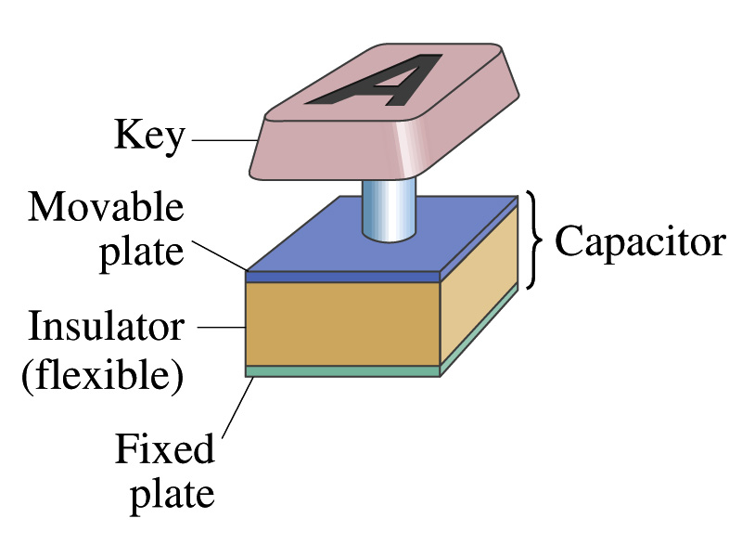
Capacitors are widely used in electronic circuits:
Store charges: camera flash; computer if power fails; part of tuner of a radio, sever as memory in RAM, key on keyboard.

Slide 6
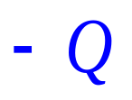
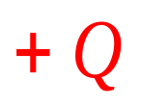
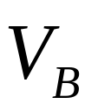

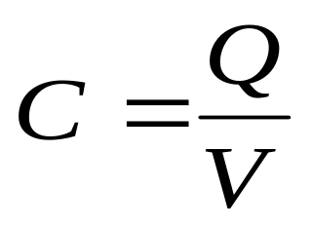
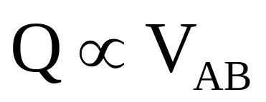
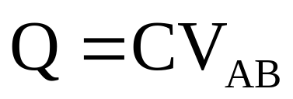
4. Definition of capacitance of a capacitor
电荷
Q
2Q
3Q
4Q
….
nQ
电势差
V
2v
3v
4v
….
nv

Slide 7
The value of capacitance depends only on the geometry (几何因素) of plates, dielectric property and not on their Q or V.
The value of capacitance depends only on the size, shape and relative position of the two conductors, also on the material that separates them.

Slide 8
5. Unit of capacitance
SI unit: coulomb per volt farad (F) (法拉)
1微法（μF）=10⁻⁶F
1皮法（pF）= 10⁻⁶ μ F
= 10⁻¹² F

Slide 9
22-2. Determination of Capacitance (P526-529)
Calculating the Capacitance
Determining capacitance (求电容步骤)：
1) Assuming a charge Q to have been placed on the plates (让导体带等量异号电荷）；
2) Finding E due to this charge (求两极板间电场)；
3) Evaluating V (求两极板间电压)；
4) Calculating C from definition (用定义C=Q/V求C).

Slide 10
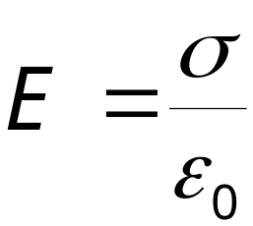

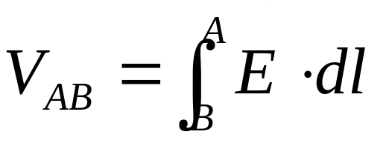
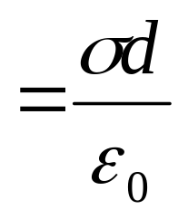
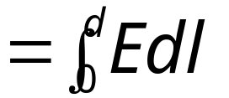


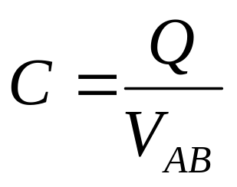
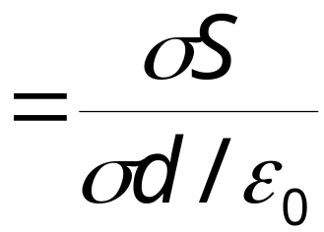
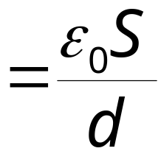

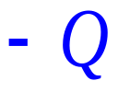
1. A Parallel-Plate Capacitor (p527)
Assume σ (charge per unit area), S (area) and d.
The field between the plates is
+ + + +++
-
-
-
-
-
-
C 与 Q 无关。

Slide 11
Example: Capacitor calculation: a) Calculate the capacitance of a capacitor whose plates are 20cm*3cm and are separated by a 1mm air gap. b) what is the charge on each plate if the capacitor is connected to a 12V battery? c) What is the electric field between the plates? d) Estimate the area of the plates needed to achieve a capacitance of 1F, given the same air gap d.

Slide 12
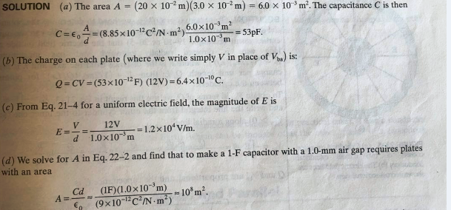

Slide 13
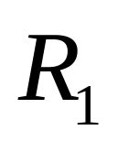
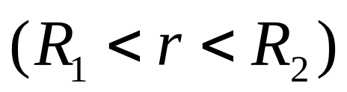

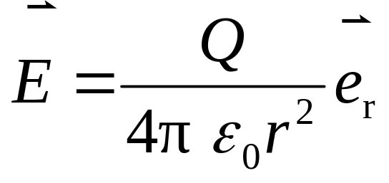
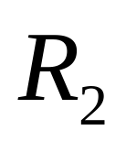

2. A Spherical Capacitor (球形电容器): P529
A spherical capacitor consist of two thin concentric spherical conducting shells. Determine the capacitance of the two shells.
Solution: The inner shell carries a uniformly distributed charge Q on its surface, and the outer
shell an equal but opposite charge –Q.
＋
＋
＋
＋
＋
＋
＋
＋
*

Slide 14
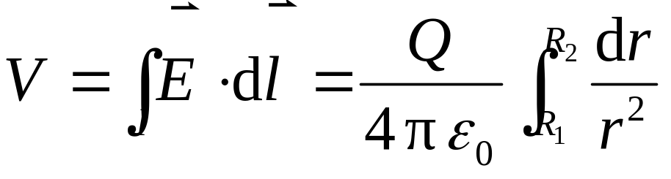
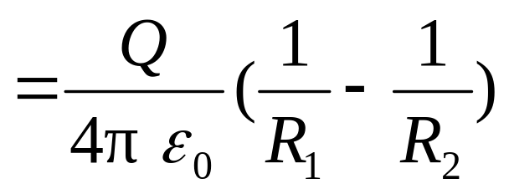
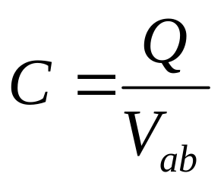
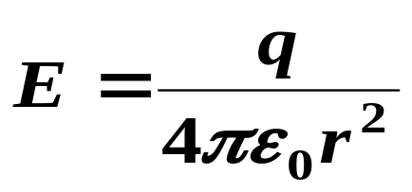
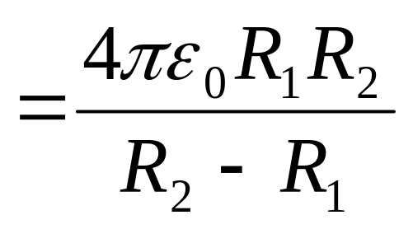
＋
＋
＋
＋
＋
＋
＋
＋
*
可看出C只与几何尺寸有关，而与 q 无关。

Slide 15
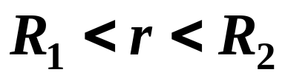
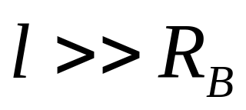
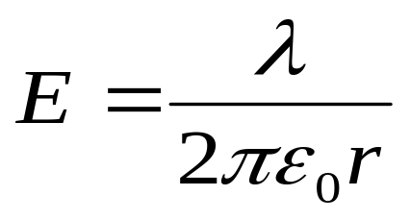

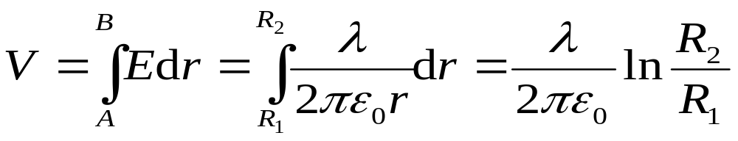


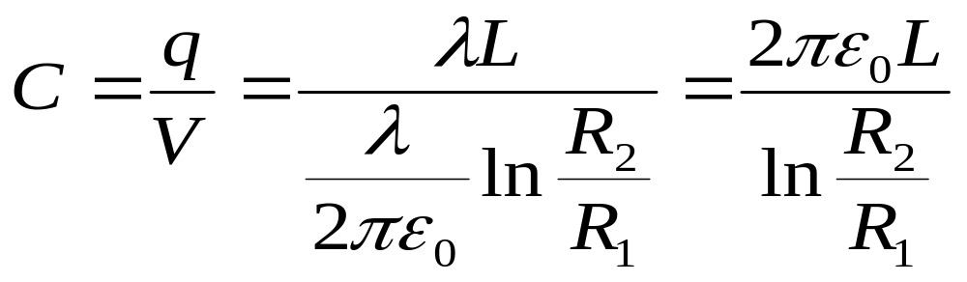
3. A Cylindrical Capacitor (圆柱形电容器): P528
In the region of ,
----
++++

Slide 16
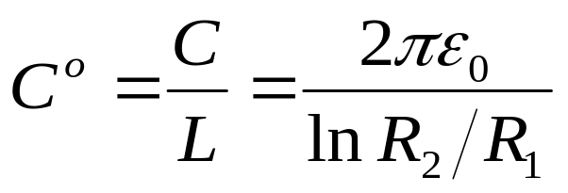
Capacitance of unit length
— depends only on geometrical factors, in this case L, R₁ and R_{2.}
----
++++

Slide 17


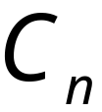



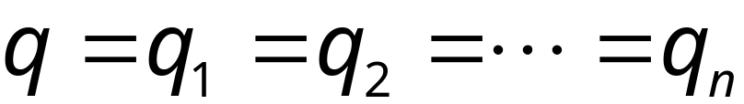


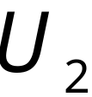

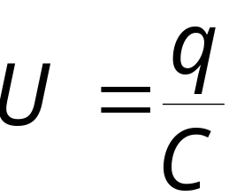

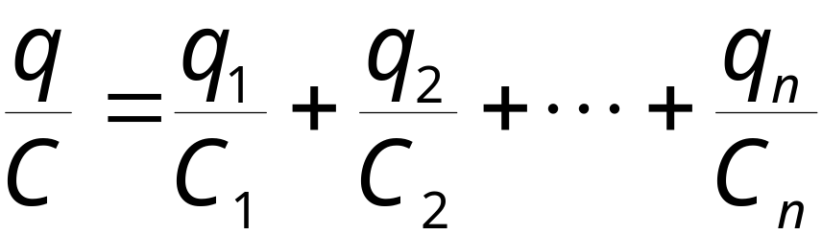
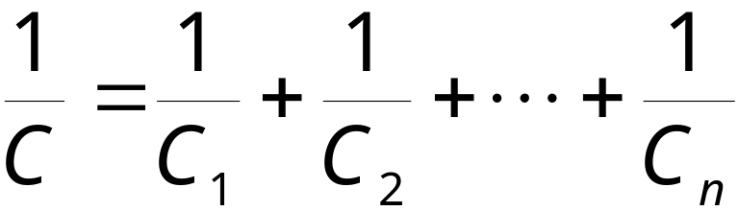
22-3. Capacitor in series and parallel (529-532)
1. Capacitors in series (电容器的串联)
features：
由
有

Slide 18
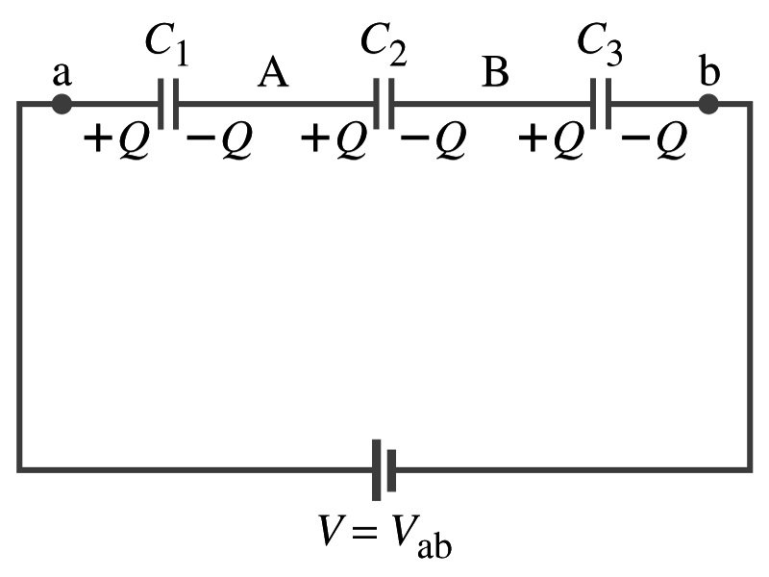

Slide 19
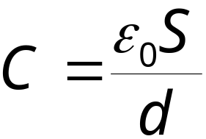
discussion
1.电容越串容量越小。
The equivalent capacitance C is smaller than the smallest contributing capacitance.
若面积S相同，相当于将极板间距增大。
2.可提高电容耐压程度，外加电压由各电容器分压。

Slide 20

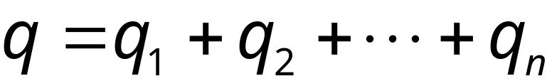
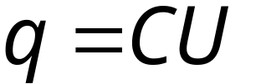
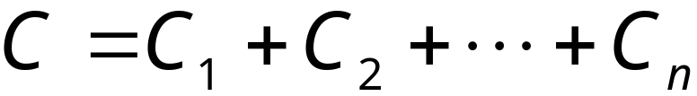
2. Capacitors in parallel (电容器的并联):
features
由
电容越并越大，若极板间距d相同，电容并联相当增加面积S 。The net effect of connecting capacitors in parallel is thus to increase the capacitance.

Slide 21


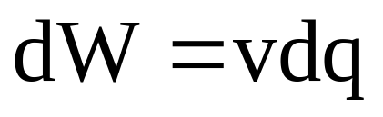

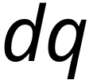
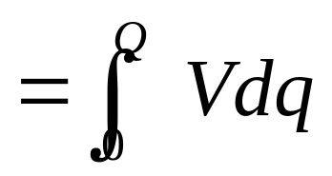


22-4. Electric Energy Storage (P532-533)
1 Electric Energy
电容器带电可看成从一个极板移动电荷到另一个极板，外力作功使电容器带电。
移动 dq 作的元功
极板带电量从0到Q作功.
The work required to bring the total capacitor charge up to a final value Q is:

Slide 22
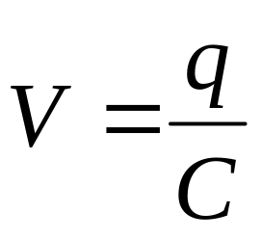
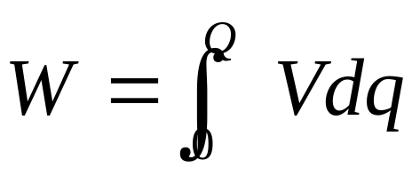
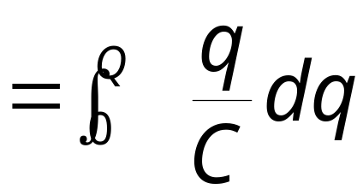
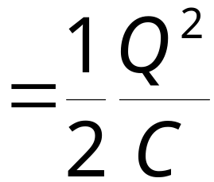
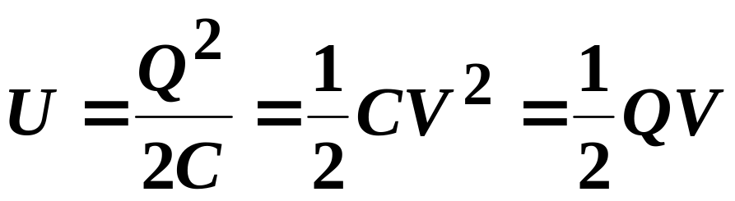
This work is stored as potential energy U in the capacitor,
电容器(Q)储能

Slide 23


2 Electric Energy Density
电容器充电后具有能量，有电荷就伴生电场，电荷与电场是不可分的，电容器的能量可以说是电场的能量。
The energy for unit-volume:
energy density (电场能量密度)

Slide 24


P543: 50
Show that the electrostatic energy stored in the electric field outside an isolated spherical conductor of radius R carrying a net charge Q is:

Slide 25
Homework 7：
P541:19
课件上所有例题

